Slide 1
Heart Disease Prediction Project.
By George Opondi.

Slide 2
INTRODUCTION
Heart disease is a type of disease that affects the heart or blood vessels. The risk of certain heart diseases may be increased by smoking, high blood pressure, high cholesterol, unhealthy diet, lack of exercise, and obesity. Heart disease describes a range of conditions that affect the heart. These diseases include:
a)Blood vessel disease, such as coronary artery disease
b)Irregular heartbeats (arrhythmias)
c)Heart problems you're born with (congenital heart defects)
d)Disease of the heart muscle
e)Heart valve disease

Slide 3
Details on the data set
This is a data set used to predict heart disease. Patients were classified as having or not having heart disease based on cardiac catheterization, the gold standard. If they had more than 50% narrowing of a coronary artery they were labeled as having heart disease.
In this cohort, there are 270 patients and there are 13 independent predictive variables or column attributes.

Slide 4
Sources
a) This data set came from the University of California Irvine data repository and is used to predict heart disease.
b) https://data.world/informatics-edu/heart-disease-prediction/workspace/file?filename=+Heart_Disease_Prediction.csv

Slide 5
Description of columns
Age: (In years)
sex: (1 = male; 0 = female)
chest_pain_type: Value 1: typical angina -- Value 2: atypical angina -- Value 3: non-anginal pain -- Value 4: asymptomatic
bp: resting blood pressure (in mm Hg on admission to the hospital)
cholestrol: serum cholesterol in mg/dl
fbs_over_120: (fasting blood sugar > 120 mg/dl) (1 = true; 0 = false)
ekg_results: resting electrocardiographic results -- Value 0: normal -- Value 1: having ST-T wave abnormality (T wave inversions and/or ST elevation or depression of > 0.05 mV) -- Value 2: showing probable or definite left ventricular hypertrophy
max_hr: maximum heart rate achieved
exercise_angina: exercise induced angina (1 = yes; 0 = no)
st_depression: ST depression induced by exercise relative to rest
slope_of_st: the slope of the peak exercise ST segment -- Value 1: upsloping -- Value 2: flat -- Value 3: down sloping
number_of_vessels_fluro: number of major vessels (0-3) colored by flourosopy
thallium: 3 = normal; 6 = fixed defect; 7 = reversable defect
heart_disease: Value 0: < 50% diameter narrowing -- Value 1: > 50% diameter narrowing

Slide 6
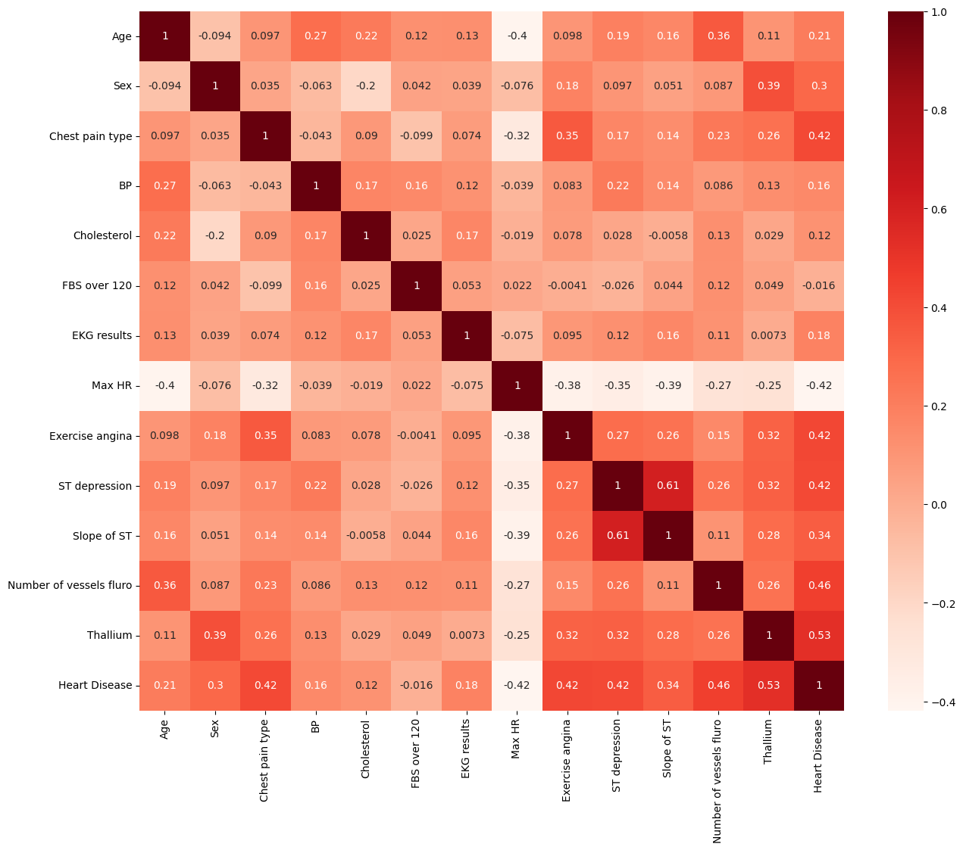
Correlation of variables

Slide 7
High correlation with output variable(Heart Disease)
Age 0.212322
Sex 0.297721
Chest pain type 0.417436
Max HR 0.418514
Exercise angina 0.419303
ST depression 0.417967
Slope of ST 0.337616
Number of vessels fluro 0.455336
Thallium 0.525020
Heart Disease 1.000000

Slide 8
GOAL OF THE PROJECT/ PROBLEM STATEMENT
The goal of this project is to develop a machine learning model that can be used to predict whether an individual is at risk of having heart disease or not based on the variables acquired from the University of California Irvine data repository.

Slide 9
Observations from EDA
The average age in the data set is 54, median is 55 and the minimum and maximum ages are 29 and 77 respectively.
All the categorical values e.g. sex have been encoded hence no need for encoding. Only the Heart disease column needed encoding.
There are also no null values in the dataset.

Slide 10
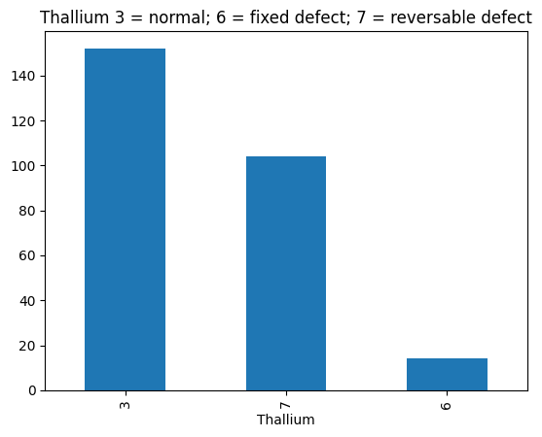
Visualizations of high correlated variables

Slide 11
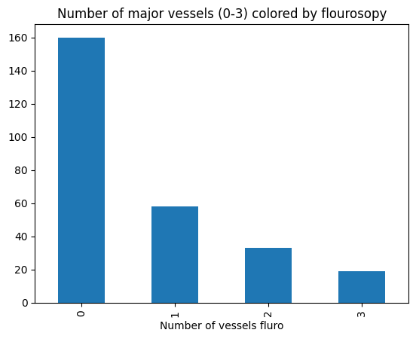
Visualizations of high correlated variables

Slide 12
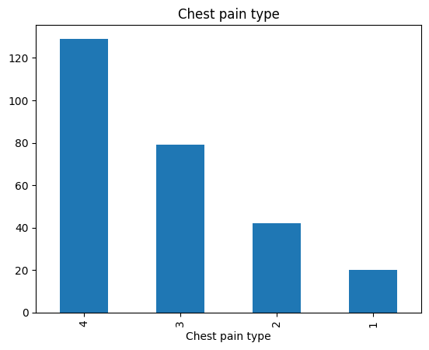
Visualizations of high correlated variables

Slide 13
Creation and selection of models
Logistic Regression: 0.8333333333333334
K-Nearest Neighbors: 0.7037037037037037
Support Vector Machines: 0.7407407407407407
Decision Trees: 0.8148148148148148
Random Forests: 0.7962962962962963
From the scores above, Logistic regression is the best Machine Learning Model to be applied for the prediction of the project.

Slide 14
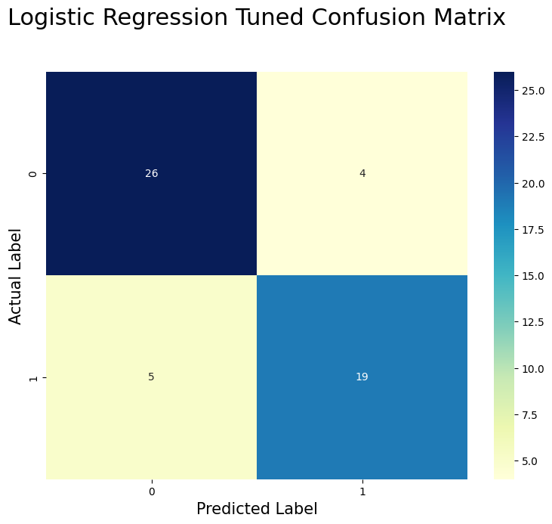
Logistic regression tuned confusion matrix

Slide 15
Development and deployment of data app using stream lit.
Here is the link to the streamlit application
https://heartdiseasepredictionprojectgi-jsa81287urq.streamlit.app/

